Slide 1
Recurrence relations

Slide 2
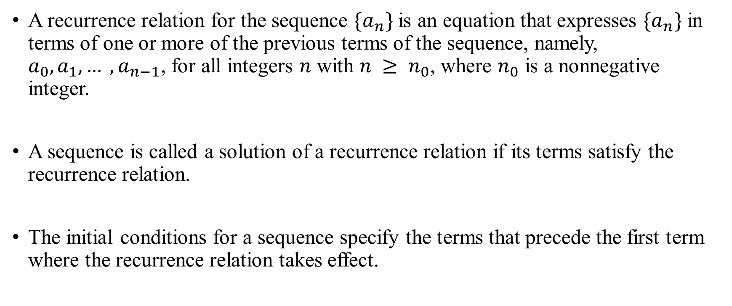
Recurrence relations Definition
A recurrence relation for the sequence $\{a_{n}\}$ is an equation that expresses $\{a_{n}\}$ in terms of one or more of the previous terms of the sequence, namely, $a_{0}, a_{1}, … , a_{n−1}$, for all integers $n$ with $n ≥ n_{0}$, where $n_{0}$ is a nonnegative integer.
A sequence is called a solution of a recurrence relation if its terms satisfy the recurrence relation.
The initial conditions for a sequence specify the terms that precede the first term where the recurrence relation takes effect.

Slide 3

Recurrence relations Example
Let $a_{n}$ be a sequence that satisfies the recurrence relation $a_{n} = a_{n−1} ∗n$ for 𝑛 = 1, 2, 3, 4, … and suppose that $a_{0} =1$.
Then:
$a_{1}=1$
$a_{2}=2$
$a_{3}=6$
$a_{4}=24$
This sequence is known as $Factorial$.

Slide 4
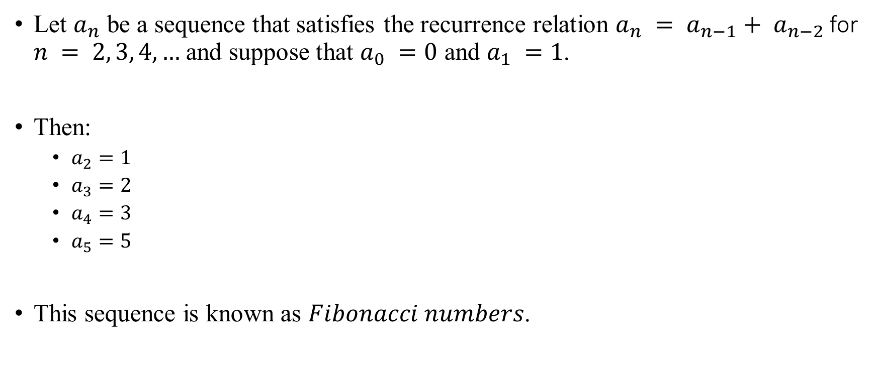
Recurrence relations Another example
Let $a_{n}$ be a sequence that satisfies the recurrence relation $a_{n} = a_{n−1}+ a_{n−2}$for $n = 2, 3, 4, …$and suppose that $a_{0} =0$ and $a_{1} =1$.
Then:
$a_{2}=1$
$a_{3}=2$
$a_{4}=3$
$a_{5}=5$
This sequence is known as $Fibonacci numbers$.

Slide 5
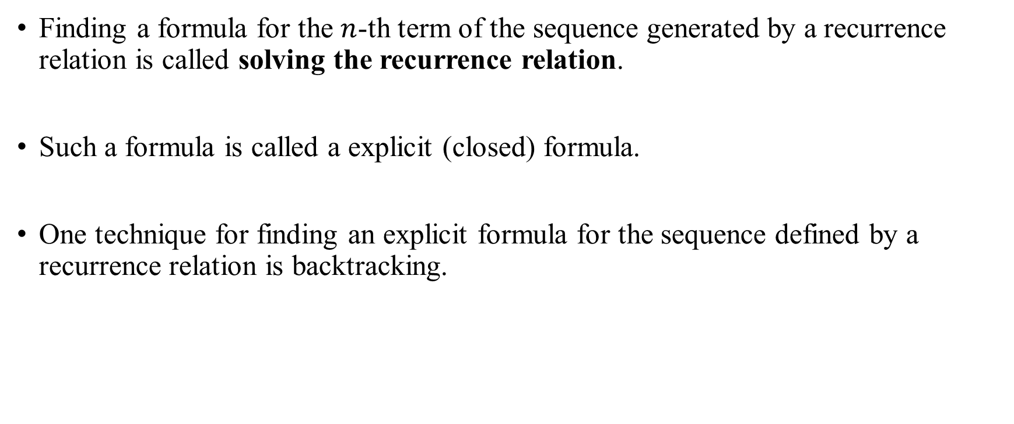
Recurrence relations Finding the formula
Finding a formula for the $n$-th term of the sequence generated by a recurrence relation is called solving the recurrence relation.
Such a formula is called a explicit (closed) formula.
One technique for finding an explicit formula for the sequence defined by a recurrence relation is backtracking.

Slide 6
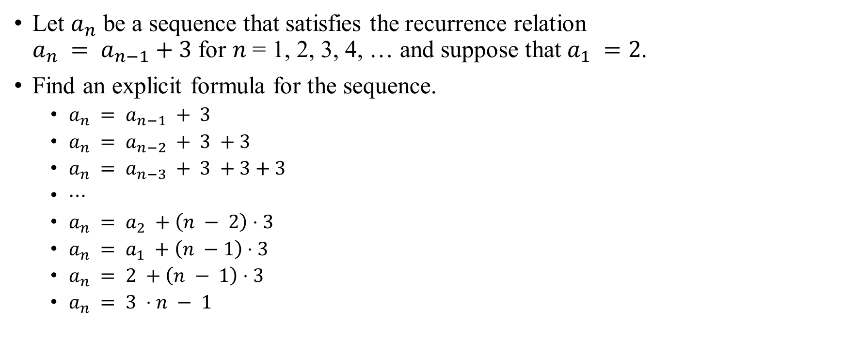
Recurrence relations Finding the formula
Let $a_{n}$ be a sequence that satisfies the recurrence relation $a_{n} = a_{n−1}+3$ for 𝑛 = 1, 2, 3, 4, … and suppose that $a_{1} =2$.
Find an explicit formula for the sequence.
$a_{n} = a_{n−1} + 3$
$a_{n} = a_{n−2} + 3 +3$
$a_{n} = a_{n−3} + 3 +3+3$
$⋯$
$a_{n} = a_{2} +\left(n − 2\right)⋅3$
$a_{n} = a_{1} +\left(n −1\right)⋅3$
$a_{n} = 2 +\left(n − 1\right)⋅3$
$a_{n} = 3 ⋅n − 1$

Slide 7
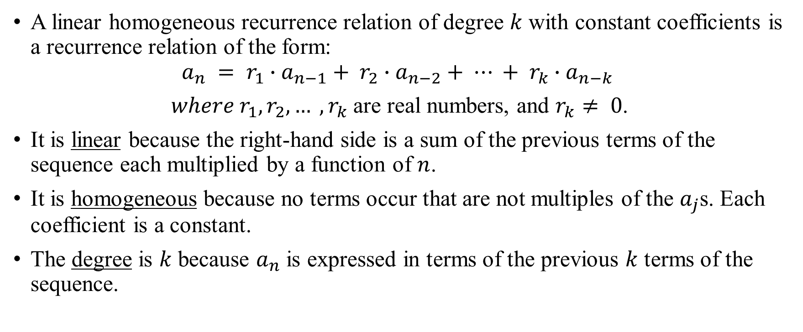
Recurrence relations Linear recurrence relations definition
A linear homogeneous recurrence relation of degree $k$ with constant coefficients is a recurrence relation of the form:
$$a_{n} = r_{1}∙a_{n−1}+ r_{2}∙a_{n−2}+ ⋯ + r_{k}∙a_{n−k}$$
$where r_{1}, r_{2}, … , r_{k}$ are real numbers, and $r_{k}≠ 0$.
It is linear because the right-hand side is a sum of the previous terms of the sequence each multiplied by a function of $n$.
It is homogeneous because no terms occur that are not multiples of the $a_{j}$s. Each coefficient is a constant.
The degree is $k$ because $a_{n}$ is expressed in terms of the previous $k$ terms of the sequence.

Slide 8

Recurrence relations Examples
$f_{n}=f_{n−1}+3$
$f_{n}=f_{n −1}+f_{n −2}$
$a_{n}=a_{n−1}+a_{n−2}^{2}$
$h_{n}=2∗h_{n−1}+1$
$b_{n}=b_{n −1} ∗(n −1)$

Slide 9
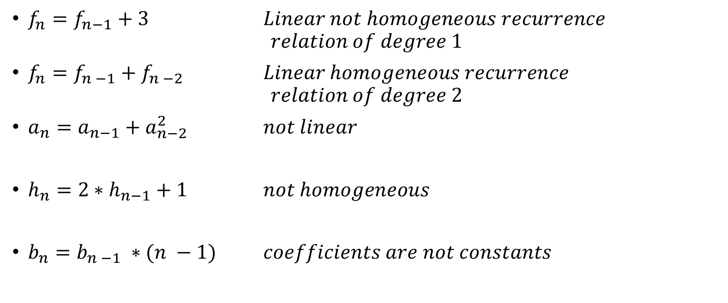
Recurrence relations Examples
$f_{n}=f_{n−1}+3$ $Linear not homogeneous recurrence$
$$relation of degree 1$$
$f_{n}=f_{n −1}+f_{n −2}$ $Linear homogeneous recurrence$
$$relation of degree 2$$
$a_{n}=a_{n−1}+a_{n−2}^{2}$ $not linear$
$h_{n}=2∗h_{n−1}+1$ $not homogeneous$
$b_{n}=b_{n −1} ∗(n −1)$ $coefficients are not constants$

Slide 10
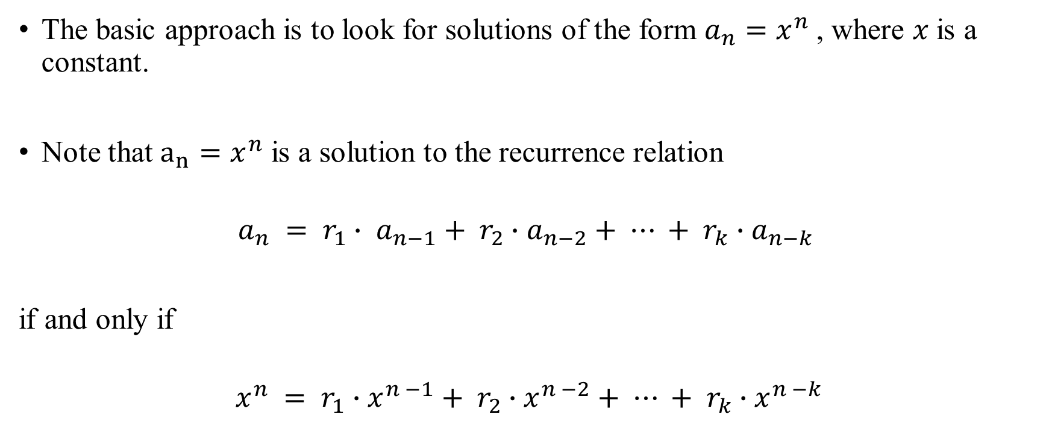
Recurrence relations
The basic approach is to look for solutions of the form $a_{n}=x^{n}$, where 𝑥 is a constant.
Note that $a_{n}=x^{n}$ is a solution to the recurrence relation
$$a_{n} = r_{1}∙ a_{n−1}+ r_{2}∙a_{n−2}+ ⋯ + r_{k}∙a_{n−k}$$
if and only if
$$x^{n} = r_{1}∙x^{n −1}+ r_{2}∙x^{n −2}+ ⋯ + r_{k}∙x^{n −k}$$

Slide 11
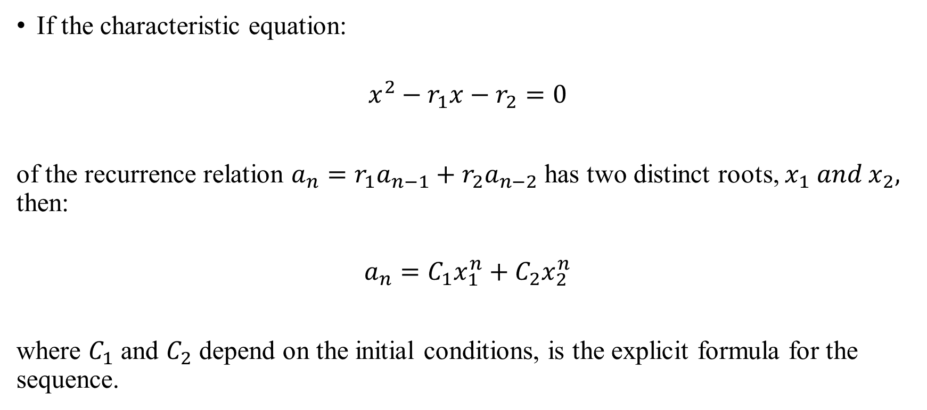
Recurrence relations Theorem 1
If the characteristic equation:
$$x^{2}−r_{1}x−r_{2}=0$$
of the recurrence relation $a_{n}=r_{1}a_{n−1}+r_{2}a_{n−2}$ has two distinct roots, $x_{1} and x_{2},$ then:
$$a_{n}=C_{1}x_{1}^{n}+C_{2}x_{2}^{n}$$
where $C_{1}$ and $C_{2}$ depend on the initial conditions, is the explicit formula for the sequence.

Slide 12
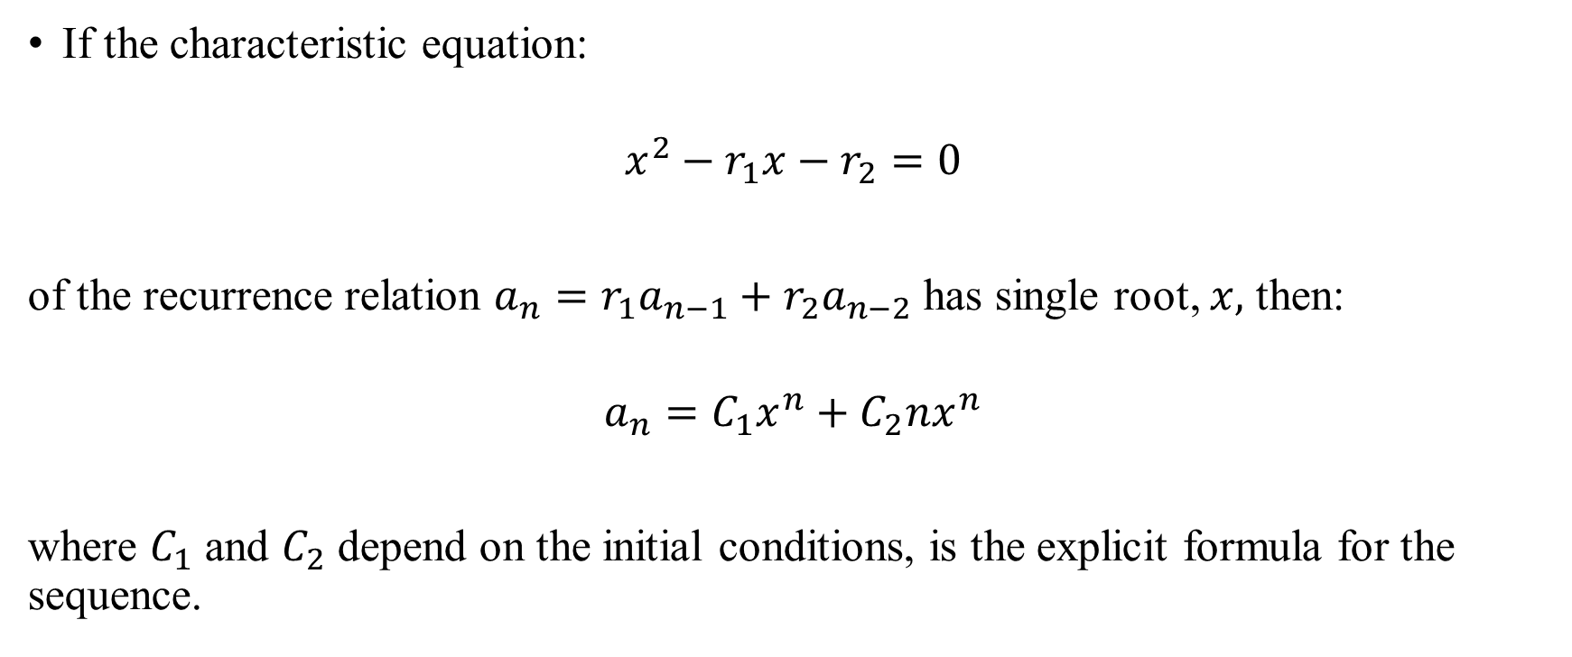
Recurrence relations Theorem 2
If the characteristic equation:
$$x^{2}−r_{1}x−r_{2}=0$$
of the recurrence relation $a_{n}=r_{1}a_{n−1}+r_{2}a_{n−2}$ has single root, $x,$ then:
$$a_{n}=C_{1}x^{n}+C_{2}nx^{n}$$
where $C_{1}$ and $C_{2}$ depend on the initial conditions, is the explicit formula for the sequence.

Slide 13

Recurrence relations Fibonacci numbers explicit formula
$$f_{n}=f_{n−1}+f_{n−2}$$
$$f_{0}=0, f_{1}=1$$
$$x^{2}=x+1$$
$x^{2}−x −1$ = 0
$$D=b^{2}−4∙a∙c= 1+4=5$$
$x_{1}= \frac{−b+\sqrt{D}}{2∙a}$ = $\frac{1+\sqrt{5}}{2}$
$x_{2}= \frac{−b−\sqrt{D}}{2∙a}$ = $\frac{1−\sqrt{5}}{2}$

Slide 14

Recurrence relations Fibonacci numbers explicit formula
$$x_{1}= \frac{1+\sqrt{5}}{2},x_{2}= \frac{1−\sqrt{5}}{2}$$
$$f_{n}=C_{1}x_{1}^{n}+C_{2}x_{2}^{n}$$
$$f_{0}=0=C_{1}+C_{2}⇒C_{1}=−C_{2}$$
$$f_{1}=1=C_{1}∙\frac{1+\sqrt{5}}{2}+C_{2}∙\frac{1−\sqrt{5}}{2}⇒C_{1}∙\frac{1+\sqrt{5}}{2}−C_{1}∙\frac{1−\sqrt{5}}{2}=1 \\ ⇒C_{1}∙\left(\frac{1+\sqrt{5}}{2}−\frac{1−\sqrt{5}}{2}\right)=1⇒C_{1}∙\sqrt{5}=1⇒C_{1}= \frac{1}{\sqrt{5}}⇒C_{2}=−\frac{1}{\sqrt{5}}$$
$f_{n}=\frac{1}{\sqrt{5}}x_{1}^{n}+−\frac{1}{\sqrt{5}}x_{2}^{n}$ = $\frac{1}{\sqrt{5}}\left({\left(\frac{1+\sqrt{5}}{2}\right)}^{n}−{\left(\frac{1−\sqrt{5}}{2}\right)}^{n}\right)$

